Slide 1



X
Predictive Analysis Customer Segmentation and Forecasting
Kalbe Nutritionals Data Scientist Virtual Internship Program
Presented by
Bastian Armananta

Slide 2
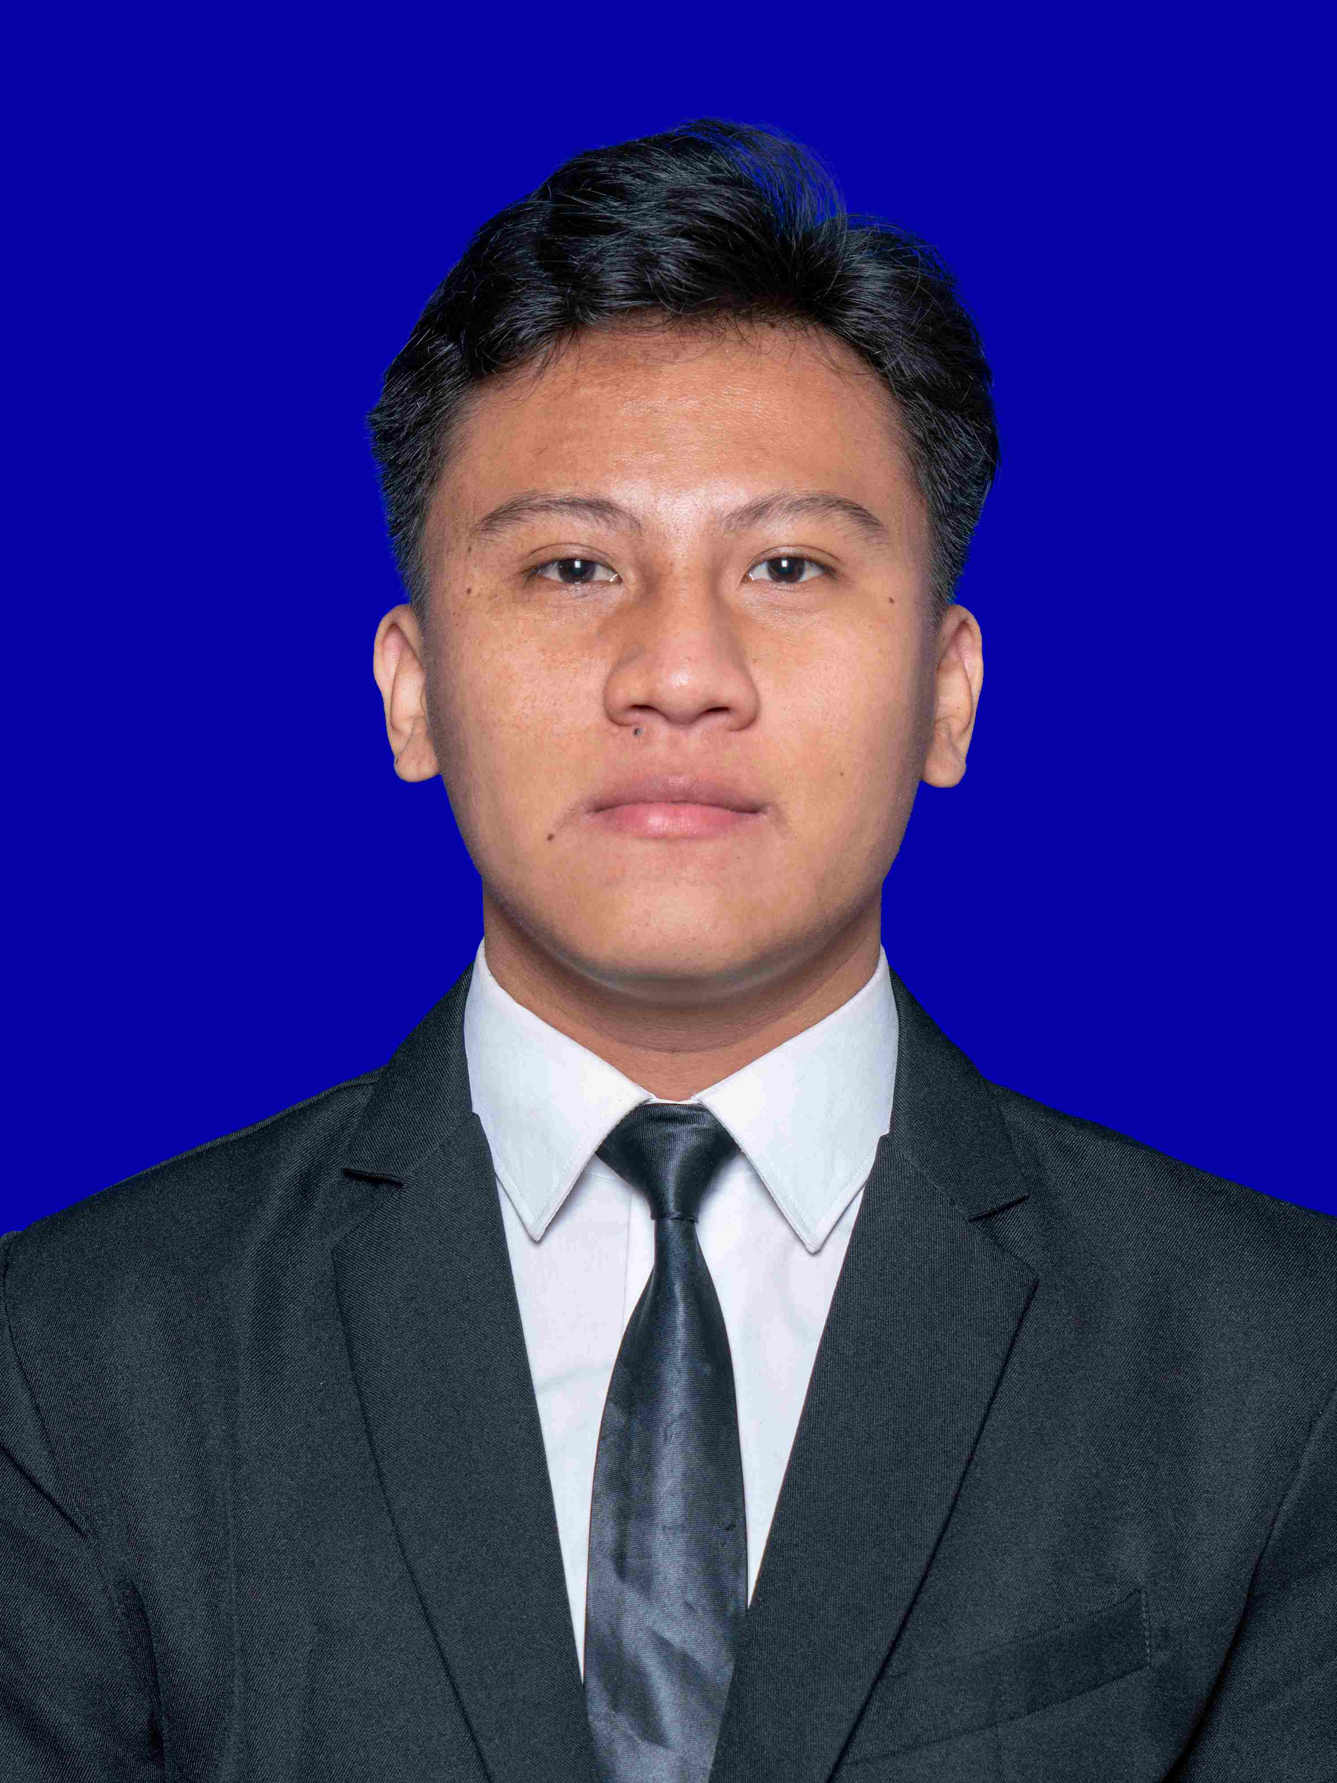

Bastian Armananta
My Experience
Google Data Analytics (Sep 2022 - Nov 2022)
About You
Huawei AI Junior Developer (Jul 2022 - Aug 2022)
My name is Bastian Armananta, and I am a fresh graduated majoring Computer Science at Institut Teknologi Telkom Purwokerto. Over the past two years, I have invested my time and efforts in studying advanced topics in artificial intelligence, deep learning, and data analysis. My enthusiasm and fascination for data analysis have motivated me to seek out future opportunities in this field.
Bisa AI Academy AI Hacker (Feb 2022 - Jul 2022)

Slide 3
Sales Forecasting Project
Developed time series analysis using ARIMA models.

Slide 4
Data
Data Customer
CustomerID
Age
Customer Gender
Marital Status
Income
Data Store
StoreID
StoreName
GroupStore
Type
Latitude
Longitude
Data Product
ProductID
Product Name
Price
Data Transaction
TransactionID
Date
Qty
Total Amount

Slide 5
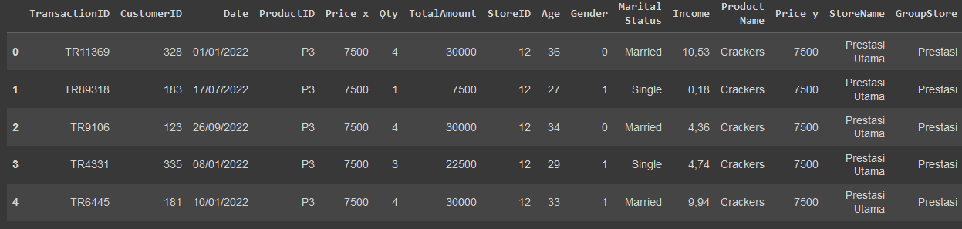
Data
DF = > Merged Data Customer and Data Transaction on CustomerID
DF => Merged DF and Data Product on ProductID
DF => Merged DF and Data Store on StoreID

Slide 6
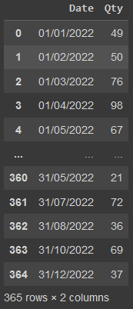
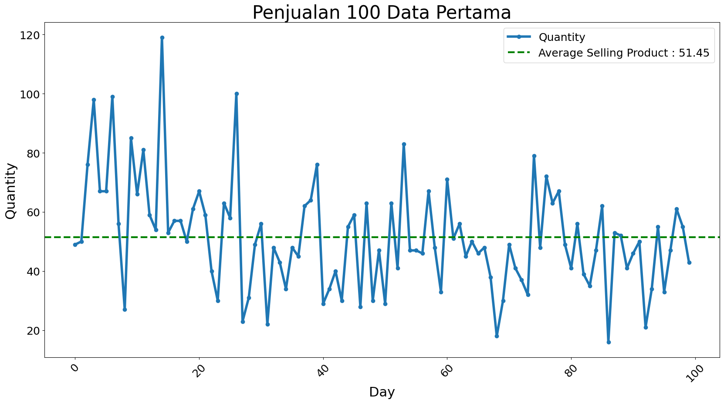
Data Agregation
Data = > Merged Data.groupby(“Date”)[‘Qty’].sum()

Slide 7
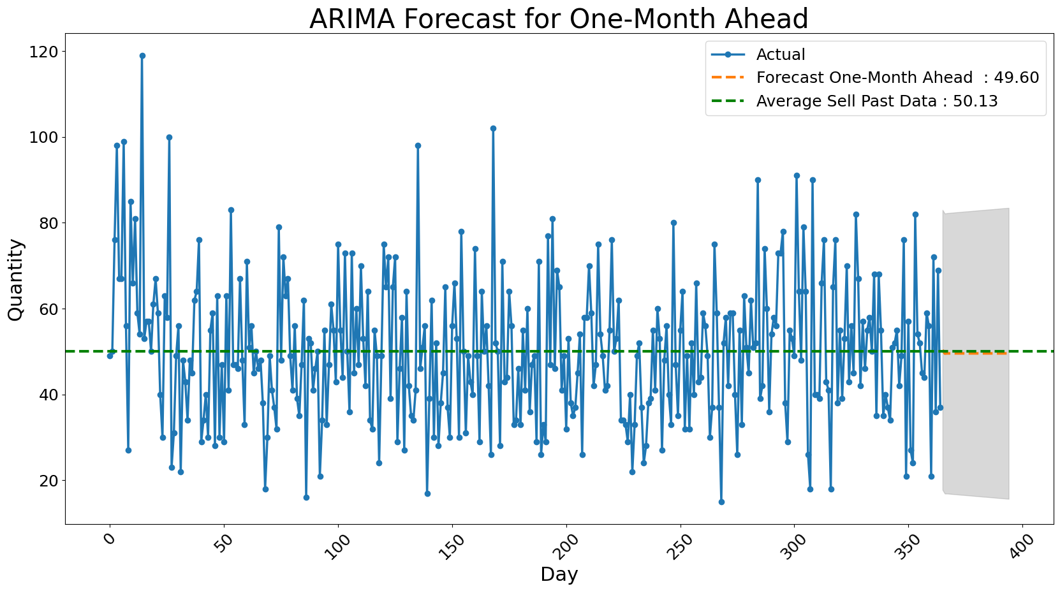
Result

Slide 8
Customer Segmentation Project
Developed customer segmentation for facilitate personalized sales treatment using KMeans model.

Slide 9
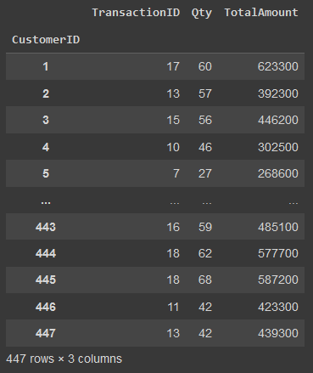
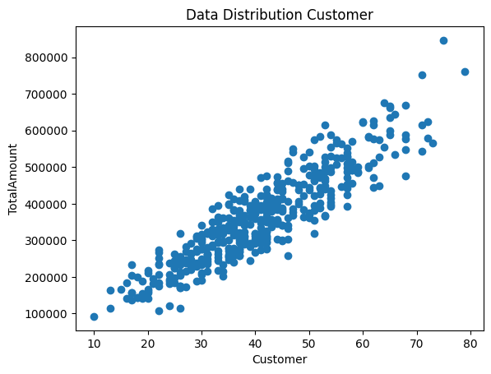
Data Agregation
Data = > Merged Data.groupby(“CustomerID”).agg({‘TransactionID’ : ‘count’, ‘Qty’ : ‘sum’, ‘TotalAmount’ : ‘sum’})

Slide 10
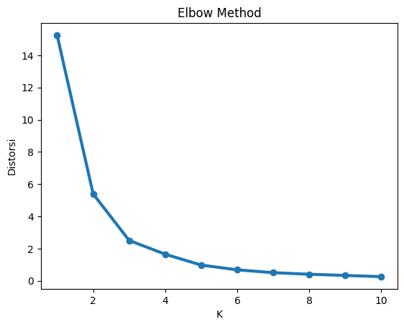
Elbow Method

Slide 11
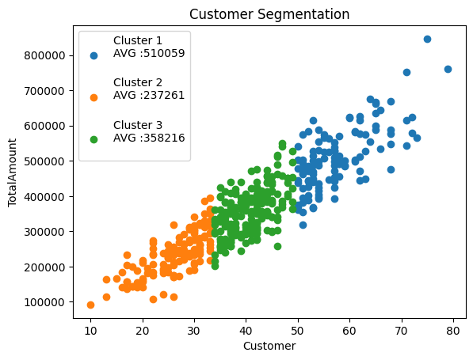
Result

Slide 12


Thank You
https://github.com/bastianarmananta
https://www.linkedin.com/in/bastian-armananta/
X

